Slide 1



Identity & Fraud Protection at No Cost
Enroll in a 2024 MetLife FEDVIP plan to gain individual access to the #1 rated* identity theft protection service.
MetLife + Aura Identify & Fraud Protection helps safeguard what matters most:
Your identity
Your money and assets
Your family
Your reputation
Your privacy
Your Individual Identity & Fraud Protection begins after you activate your service.
You can activate your service
anytime after your coverage effective date.**
We’ll provide activation instructions
by email and mail after you enroll.
Smart, simple protection with your security solutions all in one place through our convenient app.
Explore MetLife FEDVIP Benefits
MetLife.com/FEDVIP
*Ranked #1 by Security.Org and IdentityProtectionReview.com. They may be compensated as a marketing affiliate of Aura, but their ratings are all their own.
**If you enroll outside of open season, your FEDVIP coverage will be effective the first day of the first pay period following the date we receive your enrollment.

Slide 2
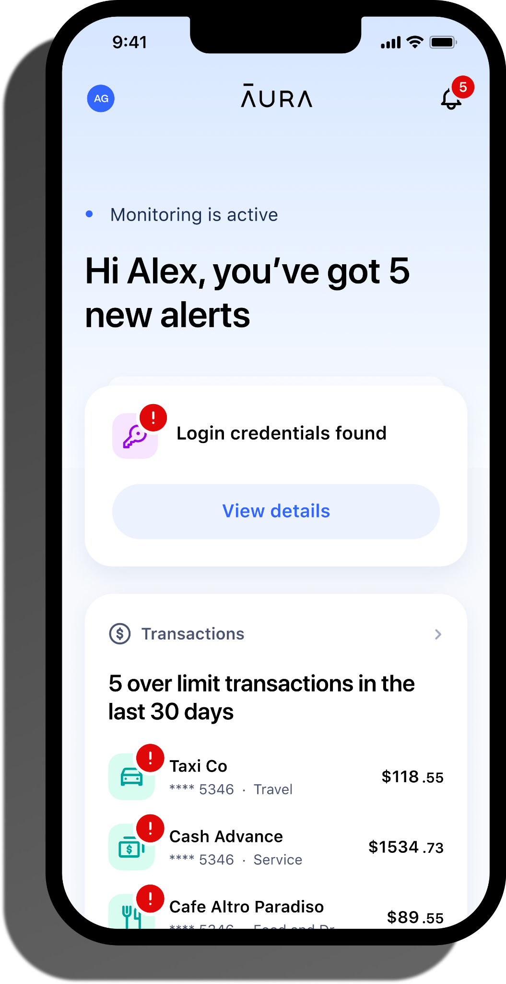
Identity & Fraud Protection
Why does identity & fraud protection matter?
Individual Protection Plan includes:
We’re online more than ever before – making us vulnerable to fraud and threats. With digital activity at an all- time high, 89% of employees say that having access to an identity theft product provides peace of mind.¹
Financial Fraud Protection
Credit Monitoring & Alerts (1 bureau) Annual Credit Report (1 bureau) Monthly Credit Score Tracker² In-Platform Credit Dispute Credit, Bank & Utility Account Freeze Assistance Home & Vehicle Title Monitoring Financial Accounts and Transactions Monitoring Investment & Loan Account Monitoring High-Risk Transaction Alerts
Identity Theft Protection
Privacy Assistant & Spam Reduction Dark Web Monitoring Digital Vault SSN & Identity Authentication Alerts Criminal, Court & Public Records Monitoring USPS Address Monitoring
Privacy & Device Protection
Password Manager Email Alias Safe Web Browsing IP Address Monitoring Wi-Fi Security/VPN (2 devices) Antivirus (2 devices)
Services and Support
$5M Insurance Policy per Enrolled Adult³ Lost Wallet Protection with $500 Emergency Cash 24/7/365 100% US-based Customer Care White Glove Fraud Resolution Services Restoration Services for Pre-Existing Fraud Events Mobile App (iOS & Android) Online Resolution Tracker
What are some of the benefits of this protection?
Aura offers robust protection by monitoring your personal info, credit, finances, and devices and alerting you of suspicious activity. It's proactive protection to help stop threats before they strike. If you are a victim of fraud, an experienced Resolution Specialist will help you navigate credit bureaus, help initiate credit freezes or a credit lock, and work with you to resolve your fraud incident.
How are my finances protected?
Aura monitors your credit, financial accounts, titles, and alerts you to suspicious changes. We will help you to take charge of your credit with our financial tools and Experian Credit Lock.
What kind of online & device security tools are available?
Every plan comes with smart safety tools including VPN/Wi-Fi security, antivirus, password manager, and more to protect your online privacy and data.
How is my identity protected?
Through extensive monitoring of your social security number, driver’s license, passport, ID, and more. Plus, our solution requests the removal of your data from broker lists to help reduce spam like robocalls and robotexts.
The Aura app keeps all
your digital security solutions in one place.
Q&A: Identity Theft Benefits More Relevant Than Ever, HR Daily Advisor (https://hrdailyadvisor.blr.com/2020/04/02/qa-identity-theft-benefits-more-relevant-than-ever/), Accessed June 2023.
The score you receive with Aura is provided for educational purposes to help you understand your credit. It is calculated using the information contained in your TransUnion or Experian credit file. Lenders use many different credit scoring systems, and the score you receive with Aura is not the same score used by lenders to evaluate your credit.
As a component of becoming an Aura Plan member, Consumers receive identity theft insurance through a group policy issued to Aura which is underwritten and administered by American Bankers Insurance Company of Florida, an Assurant company, which is not an affiliate or subsidiary of MetLife. Checking & Savings Cash Recovery and 401(K) & HSA Cash Recovery are part of and not in addition to the Expense Reimbursement limit of liability. The description herein is a summary and intended for informational purposes only and does not include all terms‚ conditions and exclusions of the policies described. Please refer to the actual policies for terms, conditions, and exclusions of coverage. Coverage may not be available in all jurisdictions.
No one can prevent all identity theft or monitor all transactions effectively.
Aura is a product of Aura Sub, LLC. Aura Sub, LLC. is not affiliated with MetLife, and the services and benefits they provide are separate and apart from any MetLife product.
MetLife Consumer Services, Inc. | 200 Park Avenue | New York, NY 10166
L1123036788[exp1125][All States][DC,GU,MP,PR,VI] © 2023 MetLife Services and Solutions, LLC.

